Slide 1
JOHN METRIO.
English class
adjectives as syllables

Slide 2

INTRODUCTION:
English adjectives precede the name and do not vary or gender or number.
-To make comparative sentences use the word "more" in front of adjectives. When the adjectives are short, add the suffix "ER" at the end of the adjective: small / smaller
- To make superlative phrases added "the most" to adjectives long, "est" to short.

Slide 3
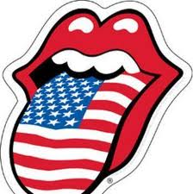
Rule 1:
When an adjective consists of one syllable add er to the end to make it a comparative adjective.
Example:
clean | cleaner
dark | darker
thick | thicker
soft | softer
warm | warmer

Slide 4
Exception to Rule 1:
If the one syllable adjective ends with a consonant-vowel-consonant we need to double the last consonant before adding the er. However, if the last consonant is a w then we follow rule 1 instead.
Example:
big | bigger
dim | dimmer
fat | fatter
fit | fitter

Slide 5

Rule 2:
When a two syllable adjective ends with y we need to replace the y with an I and then add the er.
Example:
busy | busier
dirty | dirtier
easy | easier
funny | funnier
noisy | noisier

Slide 6
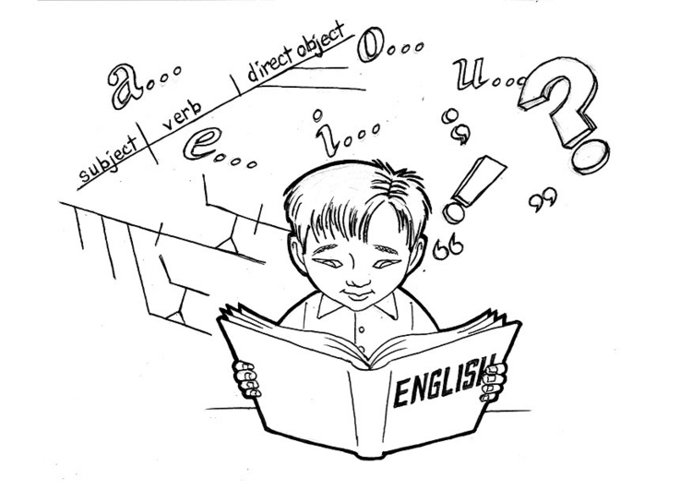
Rule 3:
For an adjective with two or more syllabus (that does not end with y), we use add the word more or less in front of the adjective.
Example:
active | more active, less active
careless | more careless. less careless
famous | more famous. Less famous
cheerful | more cheerful, less cheerful
beautiful | more beautiful, less beautiful

Slide 7
Exceptions:
There are some adjectives that have irregular comparative and superlative forms.
 | Comparative | Superlative
good | better | best
bad | worse | worst
many | more | most
much | more | most
little | less | least
far | farther | farthest

Slide 8
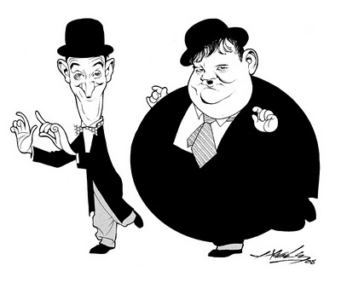
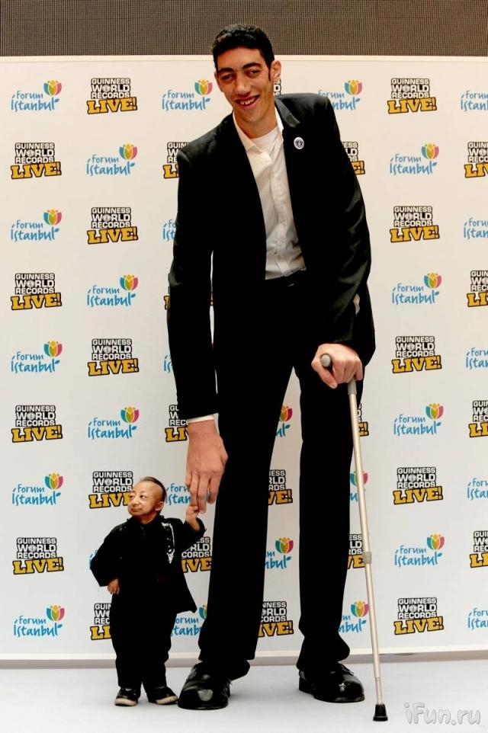
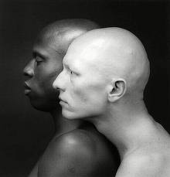
examples

Slide 9
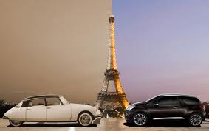
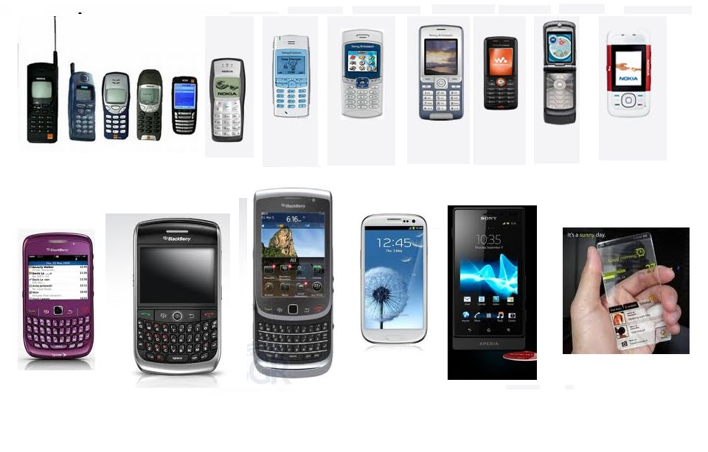

Slide 10
